Slide 1
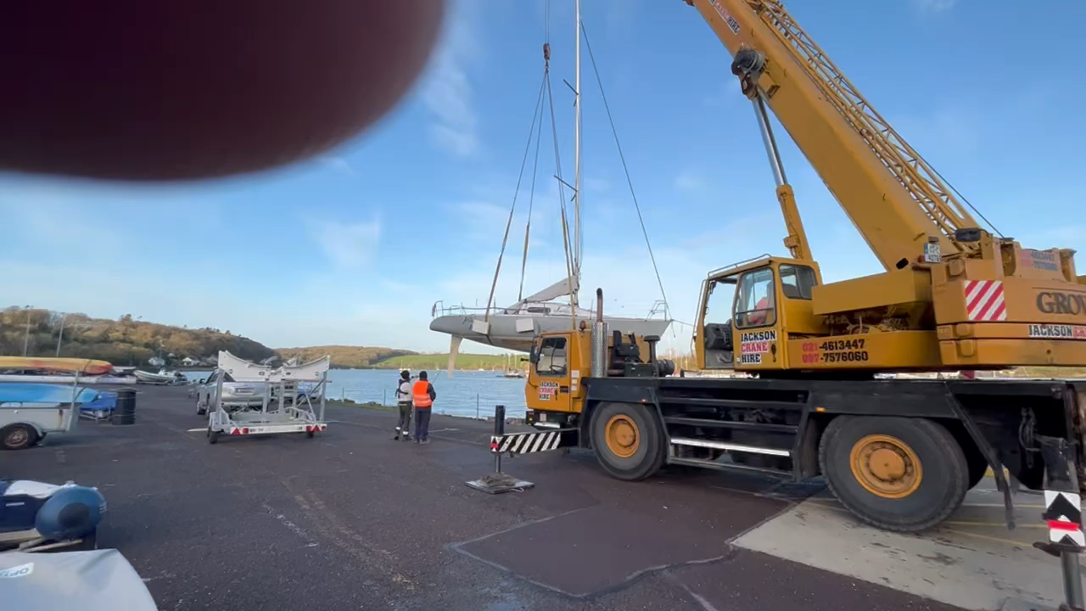
RCYC Boat Lifting Facility

Slide 2
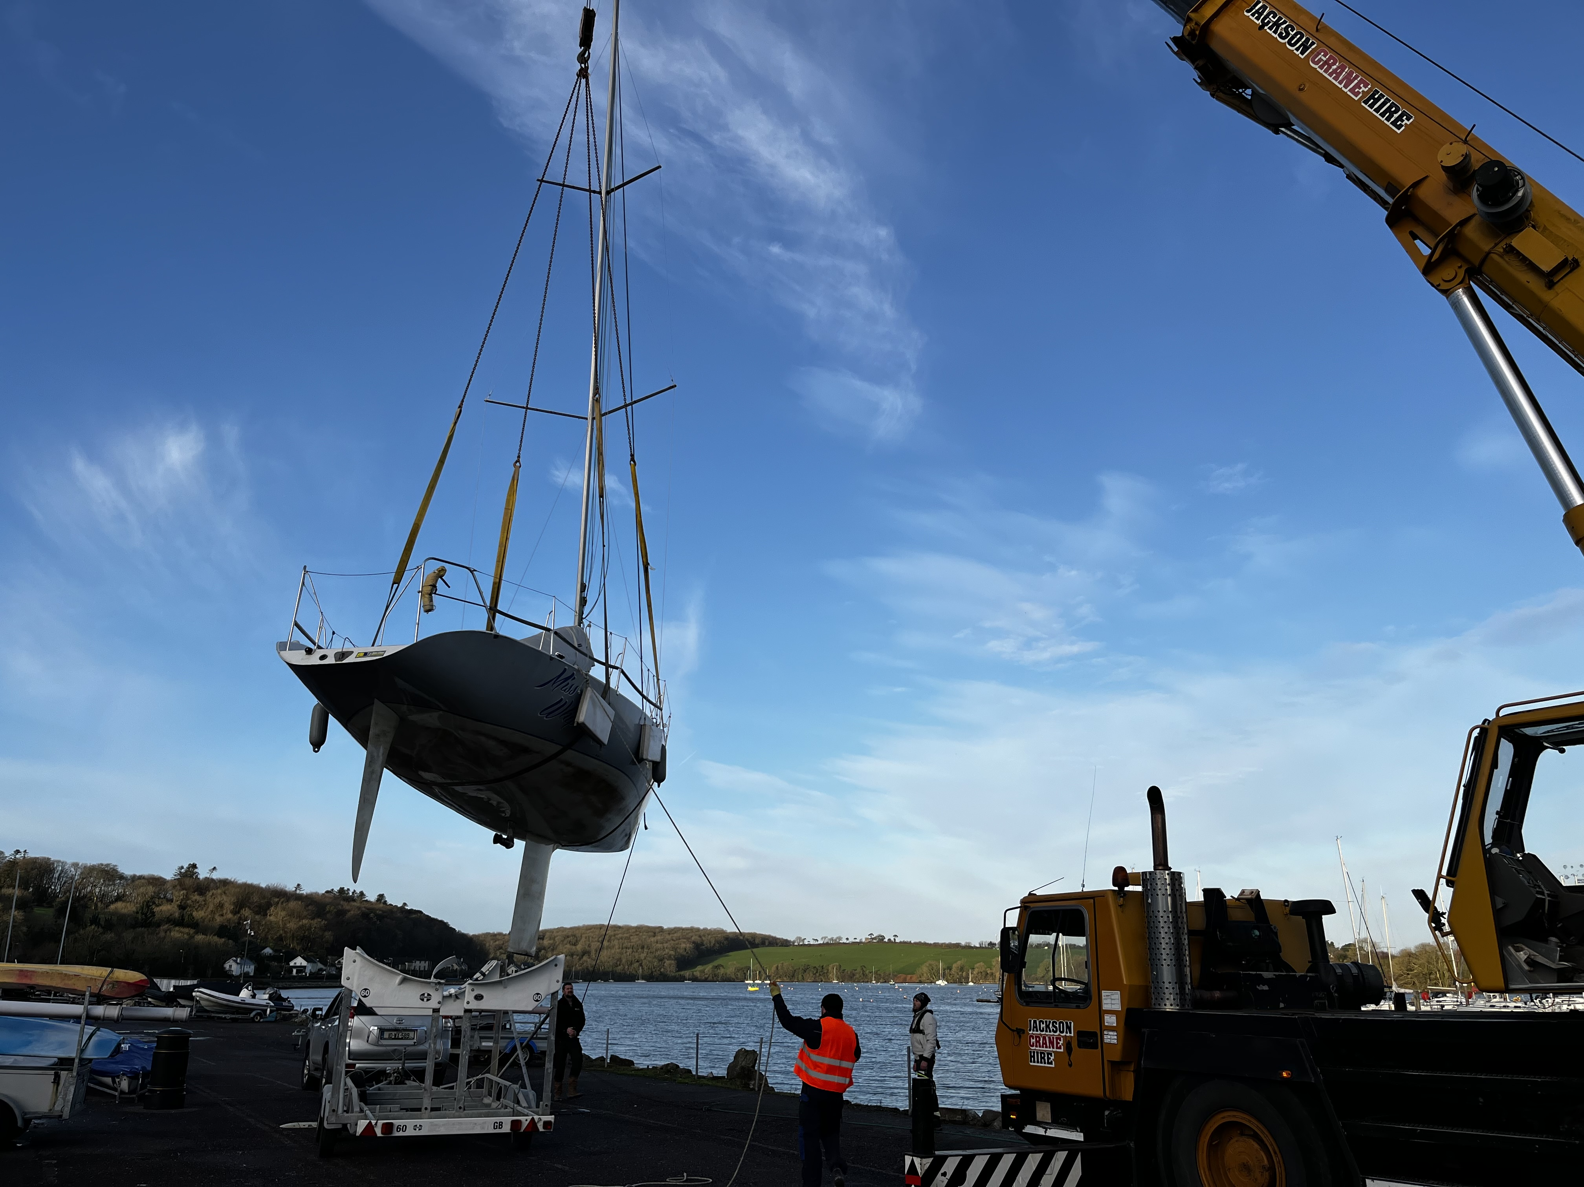
The journey so far.
Denis Byrne will give an outline of how we got to this point.

Slide 3
Days available for lifting
As we are tidally restricted, the following are samples of dates that lift will happen
MAY
Wednesday 03rd @ 17.09
Monday 15th @ 15:03
Friday 26th @ 10:28
Monday 29th @ 13:38
Wednesday 31st @ 15:34
There are 47 lift days available to us across the year that fall during working times.

Slide 4
How will a lift work?
In, May 3rd HT 17.09
Out, May 12th HT 11.18
Boat ready for lifting 2hrs before high tide
Brought to crane by staff
Boat rep helps with lines
Boat gets put in water
Boat rep takes boat to marina spot
Book in online for the use of the facility
Notes:
The boat must be ready for lifting for the allotted time, or it won’t be lifted.
The boat must have means of getting from the crane pontoon to the marina spot.
For lifting out, a boat must be ready to lift before coming to the crane pontoon.
Safety will be a big part of this, and staff are only allowed to move the boats around the site for lifting.
This Facility does not make the club boat park a boat maintenance yard.

Slide 5
What are the Costs for the year, and what do you get?
€76 per foot.
Rafting on the Marina in the designated area.
Boat stored in the club when not in water.
The trailer is stored in the club all year.
Use of crane on any of the days set out in the online form.

Slide 6
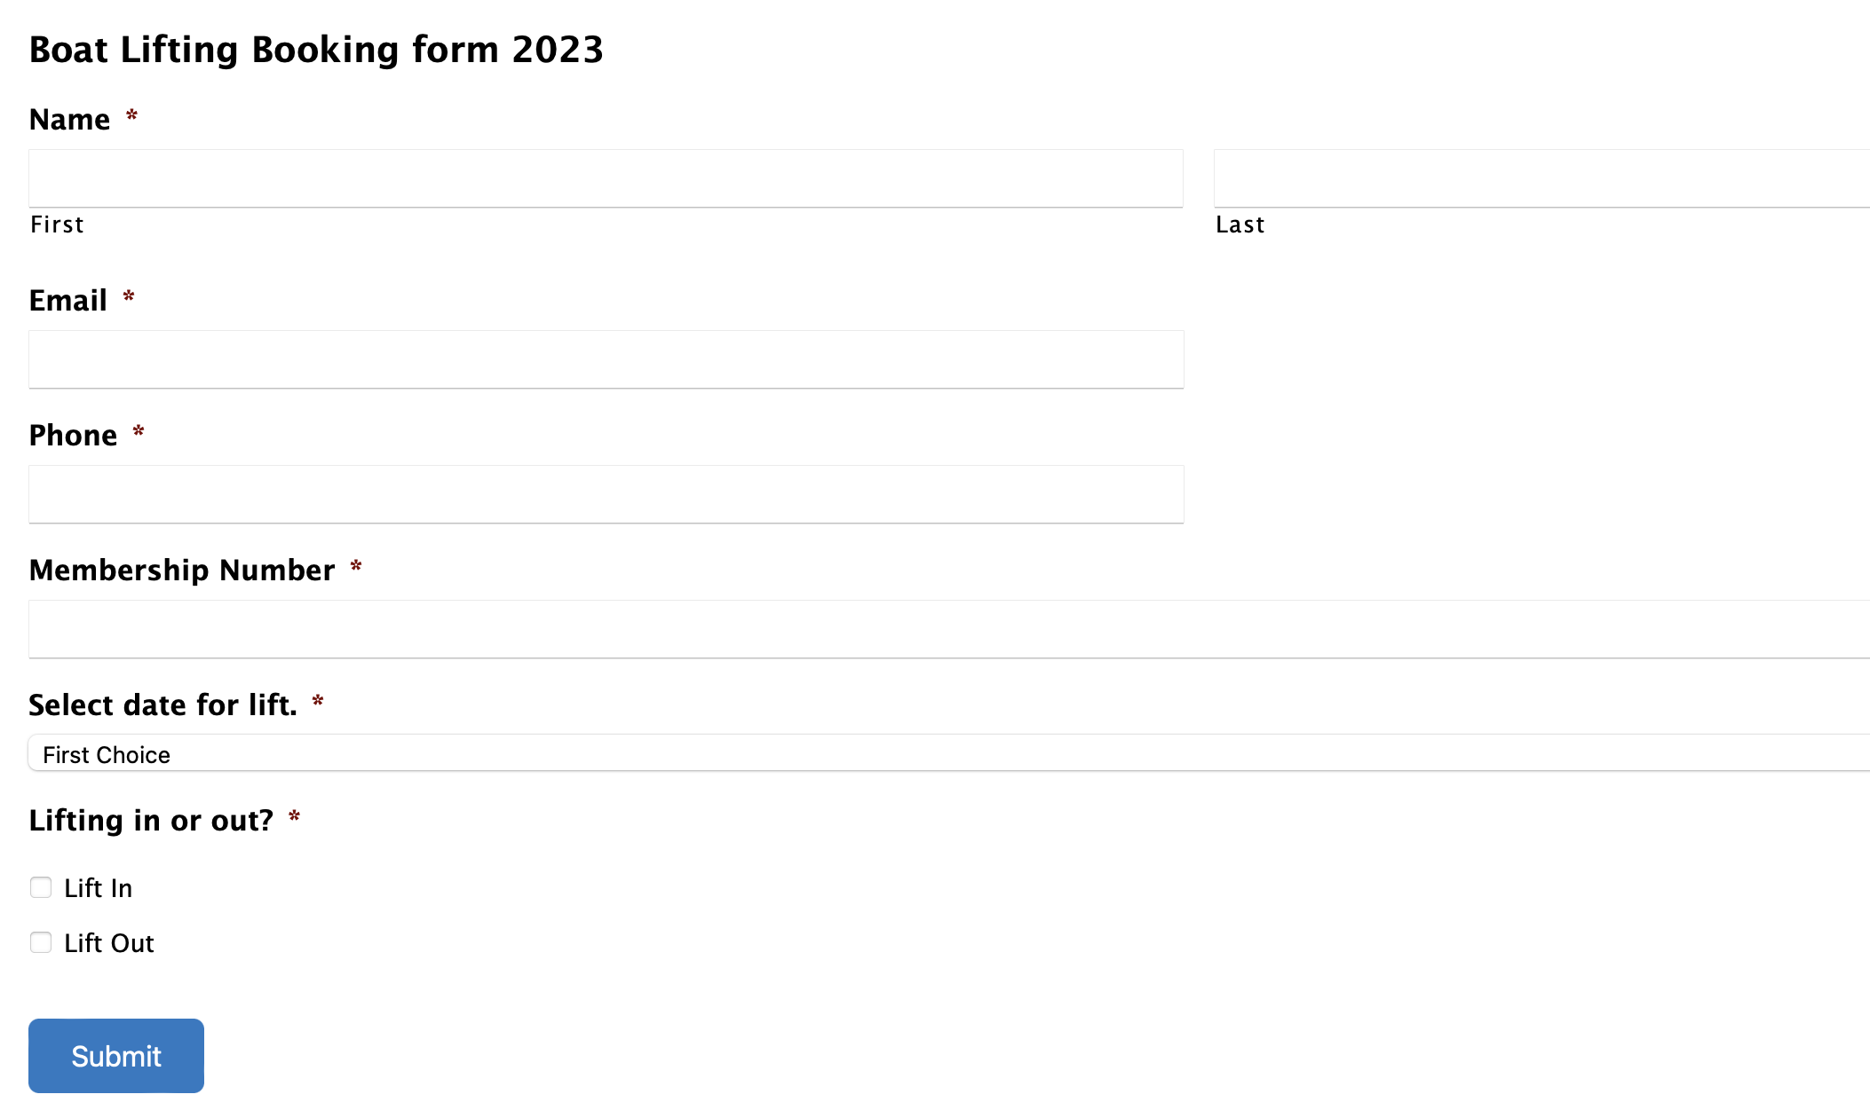
How to Book in for use of the Facility.
Log on to the club site and open the booking form.
Fill out the form and pick the date you wish to book for lifting In or Out.
Have a boat rep on hand with boat on day of lift

Slide 7

Let’s talk about what's next
There will be limitations, and this will need the support of all involved
We will need to refine the system to ensure the best results constantly.
We will have some preparatory works to be done over the next few weeks
We need to appoint a representative from this group to work with us in the development and implementation of the safety aspects of the facility

